Slide 1
Stochastic Simulation Overview
Statistics Review
Stochastic Processes
Discrete Example: Ion Channels
Continuous Example: Position of Molecule’
PROJECT 1 DUE
Great reference site for statistics: http://mathworld.wolfram.com/topics/ProbabilityandStatistics.html
Notes:
POINTS:
Identify types of protein regulation – small molecule, protein, covalent
Identify chemical basis of regulation – allosteric, direct, location
Identify how genes are regulated – protein repressors and activators
Networks are complex, modular, robust, and noisy
ODEs won’t suffice in many cases.

Slide 2
Stochastic Processes
Methods so far are deterministic
Each time the simulation is run with same inputs and parameters, you get the same output.
What are sources of randomness in biological systems?

Slide 3
Stochastic Process:
Underlying process is stochastic.
Noise may reflect error in the measurement but also reflects noise in the underlying system.
Noise in behavior at early time points affects the behavior at later times.
Measurement Error:
Underlying process is deterministic
Noise is only error in the measurement.
Noise observed at early time points does not affect the behavior at later times.

Slide 4
Stochastic Processes
Stochastic Process:
Underlying system involves probability.
Some common stochastic processes in biology:
The state of a molecule
The number of molecules for each molecule type in a system
The location of a molecule (diffusion)
The time until a molecule changes state
How is this distinct from issues of measurement error that we discussed in model identification?

Slide 5
What Processes are Stochastic?
All the processes in biology are stochastic
But, with large numbers of objects, we can ignore it.
With small numbers, we can’t:
Gene copies (1 or 2 per cell)
Transcription factors (10 per cell is typical)
Small number of enzymes
Small number of proteins that are active
Small number of proteins in the location needed for activity.

Slide 6
Robustness
It is often said: “Biological systems are robust”
What does this mean?
Resistance to noise in :
Initial conditions
Parameters (arise from mutations)
Behavior (stochastic systems when small number of a molecule),
How do we know this?
Makes sense: otherwise, organisms would die.
Natural and engineered mutations demonstrate this.
Is negative feedback enough to cause robustness?

Slide 7
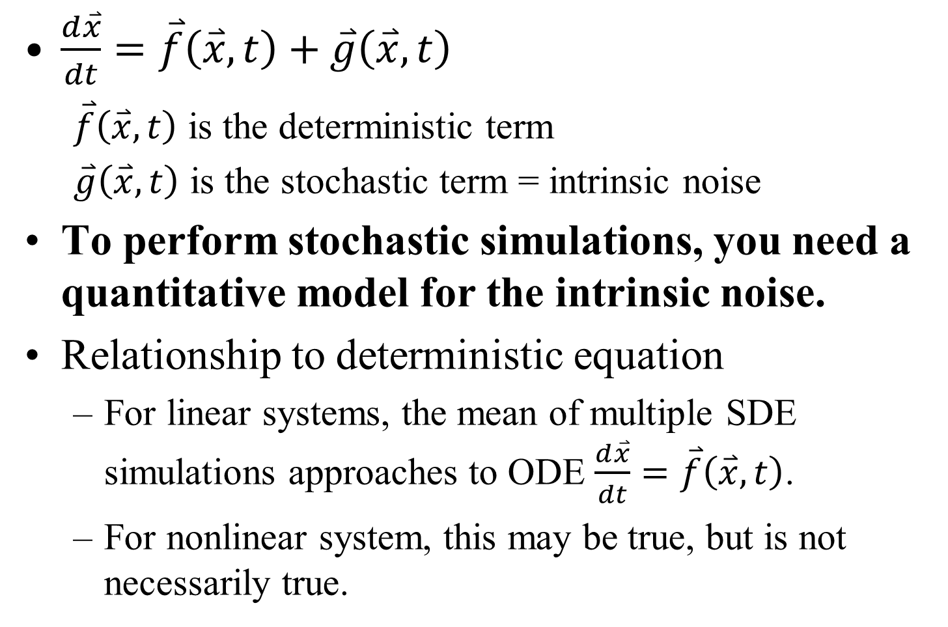
Stochastic Differential Equations
$\frac{d\overset{⃑}{x}}{dt}=\overset{⃑}{f}\left(\overset{⃑}{x},t\right)+\overset{⃑}{g}\left(\overset{⃑}{x},t\right)$
$\overset{⃑}{f}\left(\overset{⃑}{x},t\right)$ is the deterministic term
$\overset{⃑}{g}\left(\overset{⃑}{x},t\right)$ is the stochastic term = intrinsic noise
To perform stochastic simulations, you need a quantitative model for the intrinsic noise.
Relationship to deterministic equation
For linear systems, the mean of multiple SDE simulations approaches to ODE $\frac{d\overset{⃑}{x}}{dt}=\overset{⃑}{f}\left(\overset{⃑}{x},t\right)$.
For nonlinear system, this may be true, but is not necessarily true.

Slide 8
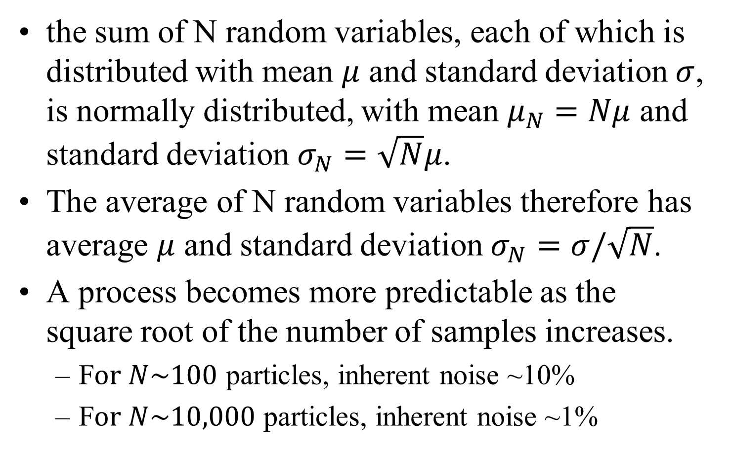
Central Limit Theorem
the sum of N random variables, each of which is distributed with mean $μ$ and standard deviation $σ$, is normally distributed, with mean $μ_{N}=Nμ$ and standard deviation $σ_{N}=\sqrt{N}μ$.
The average of N random variables therefore has average $μ$ and standard deviation $σ_{N}=σ/\sqrt{N}$.
A process becomes more predictable as the square root of the number of samples increases.
F$or N\sim 100$ particles, inherent noise ~10%
F$or N\sim 10,000$ particles, inherent noise ~1%

Slide 9
Summary of when to use SDEs
When the stochastic terms are significant relative to information needed.
When the system is nonlinear, so ODEs may give fundamentally different answer than SDEs.

Slide 10
Discrete vs Continuous
Continuous Stochastic Processes
Variables are real numbers / floating points
Values vary gradually over time.
Also called diffusion processes
Examples: microtubule trafficking, cell migration
Discrete Stochastic Processes
Variables are integers
Values change suddenly at random times
Also called Jump Processes
Examples: ion channel,

Slide 11
Continuous Random Variables

Slide 12
Continuous Random Variables
X is element of (-∞, ∞), or (0, ∞), or (a,b), etc.
X is a continuous random variable
x is a realization of X; that is, a particular value
Probability density function
p(x)
Note that:
Cumulative distribution function

Slide 13
Expectation of Continuous Random Variables
Expectation or mean:
Expectation of a function of a random variable:
Since integration is a linear operator, so is expectation:
However, nonlinear combinations such as second moments:

Slide 14
Variability in Continuous Random Variables
Variance:
Standard Deviation:
Exactly like discrete

Slide 15
Two Continuous Random Variables
Expectations:
Variance:
Covariance
Relationship between variation in two variables
Exactly like discrete

Slide 16
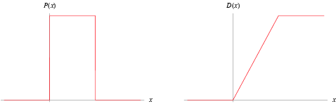
Uniform Distribution
Probability density
Cumulative distribution
http://mathworld.wolfram.com/

Slide 17
Uniform Distribution
Equal Probability of any value between a & b.
Location of particle in absence of field
Probabilities
f(x) = 1/(b - a), for a ≤ x ≤ b.
f(x) = 0 for x ≤ a or b ≤ x.
Statistics:
E(X) = (b+a)/2
Var(X) = 1/12 * (b-a)²

Slide 18
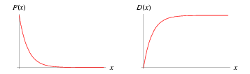
Exponential Distribution
Probability density
Cumulative distribution
http://mathworld.wolfram.com/

Slide 19
Exponential Distribution
Examples:
Vertical position of bacteria in a tube (trade-off due to settling and diffusion)
Distribution of time to next event in a Poisson process.
Valid for 0 to infinity
Probability density function:
Statistics:
E(X) = 1/λ
Var(X) = 1/λ² (σ=1/λ)

Slide 20
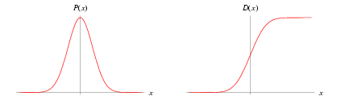
Normal (Gaussian) Distribution
Probability density
Cumulative distribution
http://mathworld.wolfram.com/

Slide 21
Normal Distribution
Examples:
Position of freely diffusing particle that started in position μ.
All distributions converge to normal distribution for large sample size
Probability density function:
E(X) = μ
Var(X) = σ²

Slide 22
Modeling Brownian Dynamics
Langevan Equation
Wiener Process & Numerical Simulations
Notes:
POINTS:
Identify types of protein regulation – small molecule, protein, covalent
Identify chemical basis of regulation – allosteric, direct, location
Identify how genes are regulated – protein repressors and activators
Networks are complex, modular, robust, and noisy
ODEs won’t suffice in many cases.

Slide 23
Modeling Diffusion: The Langevin Equation
The stochastic differential equation (SDE) of a Brownian particle is:
Where γ is a damping coefficient, m is the mass
That is, velocity decreases due to viscous drag due to collisions with surrounding fluid.
F(x,t) is any deterministic force on the particle
L(t) is a stochastic process called the Langevin force
That is, the velocity displays some random variations due to collisions with surrounding fluid.

Slide 24
Low Reynold’s numbers
The Reynold’s number is a dimensionless constant relating inertial forces to viscous forces. At low Reynold’s numbers, inertial effects are negligible.
The particle Reynold’s number uses the particle diameter, d, and velocity V relative to fluid, in addition to fluid density ρ and viscosity μ:
In these conditions, we ignore the acceleration term:

Slide 25
The Langevin Force
The stochastic Langevin Force has the following properties:
The average fluctuation is zero
Fluctuations at different times are uncorrelated
The magnitude of fluctuations is constant over time

Slide 26
The Langevin Force & Weiner Process
It is also often commonly assumed:
L(t) is gaussian
L(t) is white noise (signal has equal intensity at all frequency bands)
In this case, the Wiener Process can be defined as:
The Wiener process thus gives us the accumulated noise in a finite time interval (0 to t). This will allow for numerical approximations.
or

Slide 27
SDEs and Wiener Process
Add a stochastic term to the deterministic one:
as a differential equation, we had:
This has the general form: ,
where g(x) = 1/γ, and dW(t) = L(t).
In numerical simulations, we need to switch to discrete time:
We will show what W(Δt) is on the next slide.

Slide 28
Wiener Process
Originally developed to describe the stochastic behavior of a Brownian particle
W(Δt) is Normally distributed mean 0 and variance σ ²=Δt, or in short N(0, Δt).
Another way to say the same thing is that probability the probability of moving a unitless distance w in the time Δt is:
This is called aWiener process
Variance scales with the time step
Standard deviation scales with the square root of time step

Slide 29
Magnitude of Noise in Diffusion
What is the value g(X) that W(Δt) will be multiplied by in a simuation?
sometimes it is determined from the laws of physics
sometimes it is measured experimentally
It can be observed or proven that the mean squared distance of diffusion for an free particle over time Δt is <x²> = 2DΔt.
From this, calculate the variance in position
Recall that <x²> =σ ² when μ = 0, (<x²>= σ ² - μ ²)
Thus, σ ² = 2DΔt, or σ = sqrt(2DΔt).
Or, in terms of γ, the drag coefficient, σ ² = (2k_{B}T/γ) Δt
(since γ = k_{B}T/D by the Einstein relation)
Thus, distributed: N(0,2DΔt)
That is, stochastic term is sqrt(2D)*W(Δt), with W(Δt) = N(0, Δt). That is, g(X) = sqrt(2D)

Slide 30
Units
all terms must be m
g(x) has units D^(1/2), or m/s^(1/2).
W(Δt) has units s^(1/2).
Thus, g(x)W(t) has units meters.
f(x) has units m/s (since dx/dt =f(x) for deterministic system)
Δt has units s
Thus, f(x)Δt has units meters.
all terms must have m/s units, so units of dW(t) is s^(-1/2) (so g(X)dW(t) is m/s^(1/2)* s^(-1/2) =m/s)

Slide 31
Langevin Equation/Wiener Process
Describe the same stochastic processes, but:
Langevin Equation:
Infinitesimal time intervals (continuous time)
Allows analytical solutions to some problems
L(t) is gaussian white noise term
Wiener Process
Discrete time intervals
Allows numerical solutions to most problems
W(Δt) is the integral of L(t) and is normal distributed with zero mean and with standard deviation equal to the square root of time step.

Slide 32
Example
Remember this is only for low Reynolds numbers (sub mm scales in water):
Viscous drag dominates over inertia.
Acceleration can be neglected
Consider a particle subjected to both a spring (k) and constant force (F) as well as diffusion:

Slide 33
Gaussian/Normal Distribution in MATLAB
randn returns a random variable that is gaussian distributed with mean 0, variance 1, (and thus standard deviation 1)
randn(1,N) returns a vector of N random variables.
mu+sigma*randn gives a gaussian random variable with mean mu and standard deviation sigma.

Slide 34
SDEs with Wiener Process in MATLAB
Step 1: Calculate the Wiener Process for the discrete time step:
dt = T/N;
T is total time, N is number of steps, M is the number of variables and thus equations.
dW = sqrt(dt)*randn(M,N)
You may want to get an array of dW, one for each equation for each time step.

Slide 35
Wiener Process in MATLAB:
Step 2: Solve the SDE, but beware of prepackaged ODE solvers
% In this code, t indicates which time step, an integer.
% f and k may be calculated each loop from x(t).
dx = f*dt + k*dW(t);
x(t+1) = x(t) + dx;
In this example, f and k are constants, independent of state of x.

Slide 36
Wiener Process in MATLAB:
Why beware of prepackaged ODE solvers?
The dynamic time-stepping algorithms check whether the step was too big AFTER making the step, and reject it if it is. This will bias towards smaller random numbers, which are less likely to change the system above the threshold. So motion is minimized.

Slide 37
Example 1: Diffusion with constant force
(Particle 2 um radius in water)
dW(t)
Single run shows diffusion away from deterministic solution

Slide 38
Use Matrix format to run M times:
% array of Wiener terms:
% T = duration
N = # steps, M = # runs
dt = T/N
dW = sqrt(dt)*randn(M,N)
% initial conditions
y(1:M,1) = y0(1);
% loop through N time steps:
for j = 2:N+1
y(:,j) = y(:,j-1) …
+ F*dt + sqrt(2*D)*dW(:,j);
end

Slide 39
Analysis of SDE’s
1. view multiple trajectories

Slide 40
Analysis of SDE’s: Statistics
2. view average trajectory, and plus and minus standard deviation.
y1av = mean(y1);
y1std = std(y1);

Slide 41
Analysis of SDE’s: Statistics
3. view distribution of final values.
[freq,desc]=histogram(y1(:,N+1)')
X = linspace(desc(1),desc(2),desc(3))
plot(X,freq);
Distribution appears normal
(as opposed to bimodal, for example)
Hist command also works: see lab hints

Slide 42
Example 2: Diffusion on a spring at low Reynold’s numbers
Does not stay at x = 0.

Slide 43
Multiple trajectories

Slide 44
Statistics:
Again, mean (blue) approaches deterministic (black) solution for large M.
Standard deviation increases rapidly and holds

Slide 45
With different initial conditions

Slide 46
Mean at end of 1 second.

Slide 47
Discussion 4: Artyomov et al
Read the article, “Purely stochastic binary decisions in cell signaling models without underlying deterministic bistabilities” by Artyomov, Das, Kardar, and Chakroborty. Answer the following questions:
What are the conclusions of this paper about their model for bistability, and how are these conclusions distinct from previous work?
What are the conclusions of this paper related to T-cell signaling?
Discuss validation and any other relevant issues to analyze the level of certainty for the two conclusions you described above.

